Slide 1
Class One: Asset Owners, Intermediaries, and the Financial Landscape
Matthew Rothman
15.439 Investment Management
MIT Sloan School of Management
Spring 2022

Slide 2
Outline
What is Quantitative Asset Management?
Why Are Quants In Such Demand?
Why is the Hit Rate of Interviews to Hires Under 1% at Most Quant Firms?
Introduction to Participants in Capital Markets
Asset Owners: Common Considerations
Asset Managers (Buy Side): Intermediaries or Delegated Management
Broker-Dealers (Sell Side)

Slide 3
What is Quantitative Asset Management?

Slide 4
Quantitative Asset Management
“A quant systematically applies an alpha-seeking investment strategy that is specified based on exhaustive research”
-- Rishi Narang, p. 14
“The application by human beings of rigorous statistical methodologies to the entirety of the investment process for the systematic implementation of trading strategies.”
-- Matthew Rothman

Slide 5
Quantitative Asset Management
“The application by human beings of rigorous statistical methodologies to the entirety of the investment process for the systematic implementation of trading strategies.
“Rigorous Statistical Methodologies”: all statistical, mathematical & econometric techniques that allow for the application of scientific hypothesis testing.
“Systematic”: fully replicable, fully repeatable and fully automatable
“Entirety of the Investment Process”: (i) the ingestion, loading, transformation, mapping and normalizing of the data; (ii) the creation of the investment signals (forecasts); (iii) the process by which portfolios are constructed including the sizing of the positions and general risk considerations; (iv) the execution or trading of these positions

Slide 6
The Quantitative Investment Process
Risk
Model
Asset Universe
Return Forecasting Model
Portfolio Construction
Trading / Execution
Final Portfolio
How urgent is your order flow? Are you a liquidity taker or provider?
Where are you going to “show” your orders?
How do you measure whether you are getting “good” execution?
Did your portfolio behave how you expected it to?
How abnormal was it?
Can you explain your results and what do you want to fix, if anything?
Transaction Costs
Signal selection
Combining different signals in an optimal fashion
Model portfolio subject to risk limits and transaction costs
Risks include sector mismatch, style, individual position size
Limit execution costs

Slide 7
Quantitative Asset Management
Questions:
What isn’t a quant process? What does that look like? Where do you draw the line?
Why is “quant” controversial among many real-money investors and asset managers?
What are the strengths of quants?
What are its weaknesses?
What is a Quantamental process? (Please never call it “Fundatative”!)
Where do human beings come into this process?
Where should human beings come into a quantitative process?
Is Machine Learning the same as traditional quantitative process or different ‘in kind’? Where do the humans come in?
These are all questions we will be discussing either explicitly and implicitly all semester and you should be wrestling with and thinking about during the semester?

Slide 8
Quantitative Asset Management is not Monolithic
Types of Quantitative Investment Strategies
Equity:
Ultra High Frequency Market Making
Operate in Nanoseconds (note a blink of an eye is 400 milleseconds or 400,000 microseconds or 4e+8 nanoseconds
Highly capacity constrained; extremely highly levered; Sharpe Ratios > 6 are routine
Representative firms: Jump, Virtu, Tower, Jane Street, Citadel Securities
Statistical Arbitrage
Operate intra-day to 5-7 holding periods (two way turnover) strategies; typical portfolio holds 1,500+ stocks
Capacity constrained strategies to between several hundred million to 2 billion GMV; Sharpe Ratios ~ 2-4
Representative firms: Cubist, Millennium, Citadel GQS, PDT, Voleon, D.E. Shaw, WorldQuant, Engineers Gate, Quadrature, Qube, SquarePoint, QuantBot, Voloridge, Exodus Point, Renaissance Medallion Fund, G Research
Equity Market Neutral
Operate in days to multi-week and even some cases 1-2 months; typical portfolio holds 400-800 stocks
Typically less capacity constrained, depending on the strategy; more transparent in strategies; less leveraged generally than Stat Arb strategies SR ~ 0.8 – 1.5
Representative firms: Ergoteles, Two Sigma, QIM, Man AHL, “BGI Cubs”, Renaissance RIDGE, Blackrock 32 Capital

Slide 9
Quantitative Asset Management is not Monolithic
Types of Quantitative Investment Strategies
Equity:
Long Only
Operate in months to quarters turnover signal range; typical portfolio holds 300-600 stock
High capacity strategies with tens to hundreds of billions of AUM; no leverage; signals are low turnover; asset management based products providing tracking error relative to a bench mark in 3%-6% range; hoping to deliver SR between 0.5 – 0.8; signals; fee is lower than prior categories as is the SR
Representative firms: Acadian, AQR, Panagora, Man Numeric, QMA, QS Investors, Blackrock SAE, Geode
Enhanced Index
Similar to Long-Only but target a tracking error of 1% - 2%; typical portfolio will hold vast majority of the index with small deviations from benchmark weights; low fee product as amount of “alpha” is small
Representative firms: Investec, Geode, Vanguard Enhanced Index,
Alternative Risk Premia or Smart Beta
Operate in quarters to even multiple year horizon
Seek to produce commonly known factor returns (either long short or long-only) for a low fee; very high capacity
Representative firms: Multiple sell-side bank products; Goldman Sachs Asset Management QIS; Dimensional Fund Advisors; Research Affiliates; AQR Solutions Products; Acadian Managed Volatility Fund

Slide 10
Quantitative Asset Management is not Monolithic
Types of Quantitative Investment Strategies
Non-Equity:
Global Macro
Operate in months to quarters turnover signal range, though faster Global Macro Stat Arb firms have emerged recently
High capacity strategies with tens to hundreds of billions of AUM; most of the products tend to trade futures in multiple asset classes (equity indices, commodities, rates, fx, precious methals, etc) but some trade in spot markets as well, swaps, and other derivative products. SR are generally between 1-2 due to smaller asset breadth and lower turnover.
Representative firms: Kepos, Bridgewater, Graham Capital, BlueCcest, Centiva, Acadian Multi-Asset, MAN AHL, Millborn, CFM, Aspect
CTAs
Similar to Global Macro but traditionally have used more trend following signals. In recent years, signal set has broadened and the distinction between the two types of strategies has blurred.
Representative firms: Winton, Campbell, AlphaSimplex, Crabel, Fort, MAN AHL, Quantica
Risk Parity
Operate in weeks to month of quarters
High capacity strategies that seek to weight assets according to their volatility almost always across a variety of asset classes;
Representative firms: Bridgewater All Weather, Panagora, AQR Risk Parity, Milliman, Columbia ThreadNeedle Adapative Risk

Slide 11

It Has Never Been a Better Time To Be a Quant
Scale of web activity each second demonstrates how many digital signals we generate. Who else can make sense of this data?
10,061
tweets sent
2,116
Tumblr posts written
Every second:
96,203
YouTube videos viewed
103,335
Google searches made
1,169
photos uploaded to Instagram
6,997
Skype calls answered
3,158,772
emails sent
Source: Internet Live Stats, Oct. 2022. Image from pexels.com.

Slide 12
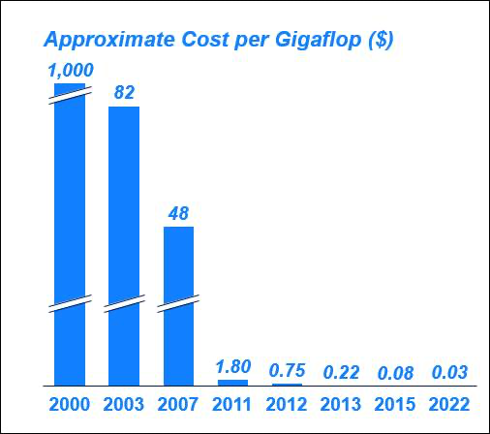
It Has Never Been a Better Time To Be a Quant
Computing Power is increasing cheap and more available. The primary reason that is so high at the moment is likely to due to crypto mining.

Slide 13
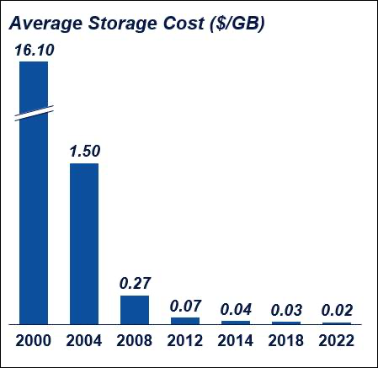
It Has Never Been a Better Time To Be a Quant
Storage Costs are exceedingly low and will go lower with new technologies and improvement in existing technologies

Slide 14
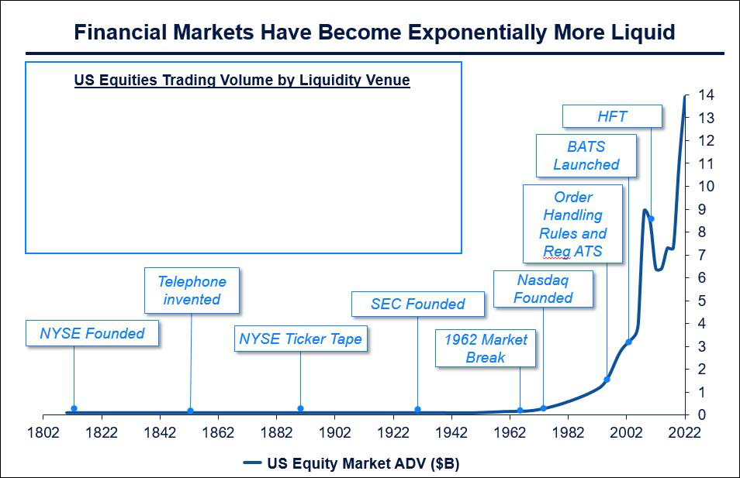
It Has Never Been a Better Time To Be a Quant

Slide 15
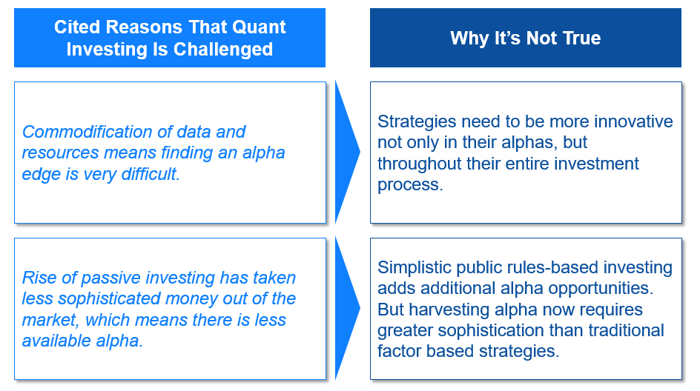
But Many People Think That Quant Investing is Challenged

Slide 16
What Constitutes Knowledge Has Changed Dramatically
If the answer to the question is available on Google: is not knowledge
Knowing the capital of every state in the United States is not knowledge
Knowing who was the 15th Vice President of the U.S. is not knowledge
Knowing how Quant funds did list year by looking them up on evestment is not knowledge
Being able to derive Ito’s Lemma is not knowledge
Knowing the formula for correcting t-statistics for serial auto-correlation is not knowledge
Knowing how to use a package in Python to apply Random Forest is not knowledge
Knowing how to implement up a gradient boosting models and classifiers using Scikit-Learn library in Python is not knowledge

Slide 17
What Constitutes Knowledge Has Changed Dramatically
If the answer to the question is not available on Google and wasn’t in your textbook: it is probably knowledge
Knowing if your regression is mis-specified
Knowing that if your R² is 99%, your analysis is wrong
Being able to recognize when your analysis make no “******” sense
Knowing that just because the BARRA tells you are hedged to a factor, you are very likely still not hedged to that factor and knowing how to actually check for that and rebuild BARRA yourself
Knowing what is a “first order” problem to worry about in your analysis and what is a “second order problem” and what are the right robustness checks
Knowing when to stop a research project and when to keep pushing
Knowing how to generalize the lessons from GFC so you aren’t just fixing yesterday’s problem but tomorrow’s also
Understanding what your model doesn’t know and what will make it blow up

Slide 18
Why Is Interview Rate to Hire Rate < 1% at Quant Firms?
Most graduating data scientists know very little about actual “data” and are not actually trained as “scientist”
Example: 4 Quadrillion Dollars
Have you gotten your hands dirty ever with data? Are you willing to?
How well do you know the “scientific process” for empirically testing strategies? Is the concept of “point-in-time” data intuitive to you?
Do you have intuition on taking your knowledge and applying to non-textbook problems?
“Computers are useless: they only give you answers”. Do you know the questions to ask?
Are you paranoid and deeply skeptical about your work? Does it make sense?
Can you communicate the “why” and “what” you have done? Does it make sense?

Slide 19
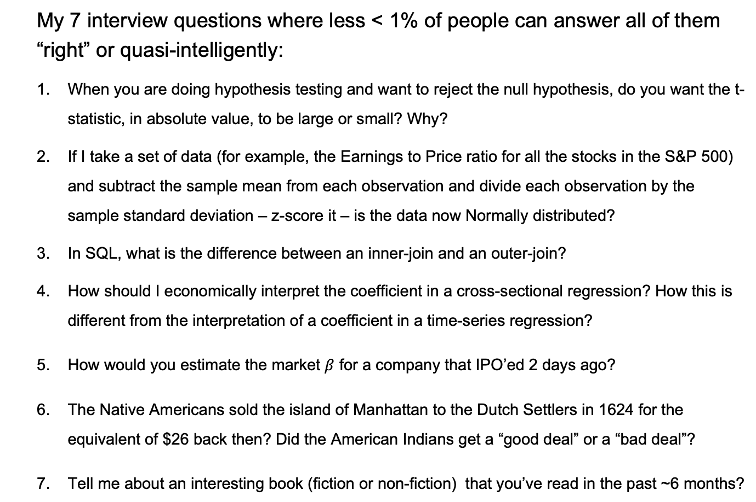
Why Is Interview Rate to Hire Rate < 1% at Quant Firms?
My 7 interview questions where less < 1% of people can answer all of them “right” or quasi-intelligently:
When you are doing hypothesis testing and want to reject the null hypothesis, do you want the t-statistic, in absolute value, to be large or small? Why?
If I take a set of data (for example, the Earnings to Price ratio for all the stocks in the S&P 500) and subtract the sample mean from each observation and divide each observation by the sample standard deviation – z-score it – is the data now Normally distributed?
In SQL, what is the difference between an inner-join and an outer-join?
How should I economically interpret the coefficient in a cross-sectional regression? How this is different from the interpretation of a coefficient in a time-series regression?
How would you estimate the market $β$ for a company that IPO’ed 2 days ago?
The Native Americans sold the island of Manhattan to the Dutch Settlers in 1624 for the equivalent of $26 back then? Did the American Indians get a “good deal” or a “bad deal”?
Tell me about an interesting book (fiction or non-fiction) that you’ve read in the past ~6 months?

Slide 20
Common Issues for Asset Owners

Slide 21
Investors
Who?
Individual, collective owner (e.g. family or pension fund), endowment/foundation, corporation, nation (e.g. sovereign wealth fund)
Why?
Liabilities, aims, and goals of the asset owner
What?
Properties of different assets to meet the goals of the asset owner
How?
Delegated portfolio management and principal-agent issues

Slide 22
Asset Owners
Despite the heterogeneity of asset owners, all share common issues
Preferences: How to measure how an investor cares about returns in different states of the world. Some states (e.g. crashes) may be more painful than others.
Risk Aversion: How much risk an investor can tolerate
Liabilities
Cash outflows can be contractual, like fixed liabilities, or endogenously determined, like consumption
Income
Cash inflows can be zero in some cases, like some foundations
Some investments can even have negative cash “inflows”. Example?
These are investor-specific characteristics

Slide 23
Principal-Agent Issues
Asset owners generally do not invest on their own. They usually hire intermediaries. This gives rise to an agency problem.
Principal: asset owner. Agent: delegated investment manager(s)
The principal and agent do not usually have the same goals. Usually, the agent has incentives to deviate from the principal’s optimum.
Example?
How should the contract be structured?
How much in total should the intermediary be paid?
How to monitor the agent? How do you know if she is doing a “good job”?
Certain investment vehicles, like private equity/venture capital, or hedge funds, represent a certain style of contracts and access particular types of risk premiums (like illiquidity risk, volatility risk, momentum risk, etc). Private equity and hedge funds are not asset classes.

Slide 24
Sovereign Wealth Funds

Slide 25
Sovereign Reserves
There is no universally accepted definition of a SWF.
SWFs are part of sovereign savings, which include central bank reserves, commodity savings or stabilization funds, pension reserves or social security funds, and government holding management companies.
Working definition:
Investment fund controlled by a government and invested (partly or wholly) in foreign assets
Notes:
First coined by Andrew Rozanov, State Street 2005

Slide 26
Sovereign Wealth Funds
Oldest SWF is Kuwait’s, established in 1953
SWFs in the US, all at the state level:
Texas Permanent University Fund, established in 1876(!)
New Mexico Severance Tax Permanent Fund, established 1973
Wyoming Permanent Mineral Trust Fund, established 1974
Alaska Permanent Fund, established 1976
Alabama Trust Fund, established 1985
North Dakota Legacy Fund, established 2011
Distinguishing characteristic is government ownership

Slide 27
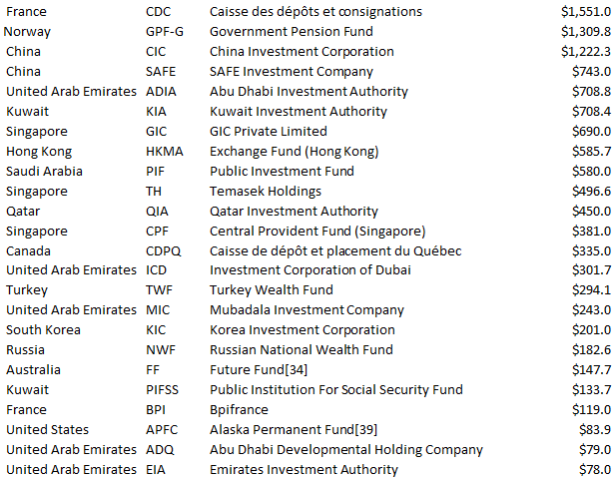
Largest SWFs
Largest Sovereign Wealth Funds (USD billion) [SUSPECT!]
Notes:
Suspect because some of these institutions (eg GIC) do not publicly report their AUM.

Slide 28
Sovereign Reserves
SWFs are just one vehicle for holding sovereign wealth.
The line between reserves, SWFs, and state-owned companies is increasingly blurred:
Central banks like Switzerland, SAFE (China), Norway, Japan hold equities and risky assets closer to traditional SWFs.
Certain SWFs, like Chile’s Economic Stabilization Fund and Russia’s Reserve Fund, hold highly liquid, safe instruments closer to central banks.
What is exactly is a State Owned Enterprise (SOE)? Is it a public company? Is it a government agency? What metrics do you use to value it? Some of the biggest companies in the world are SOEs.

Slide 29
Impacts of SWFs
Although not new, the rise of SWFs over the last decade reflects two broader, related geopolitical trends:
Redistribution of wealth away from the Western world (US, Europe, and other mature developed economies) to the East and developing countries
An increasing role of governments in managing wealth, creating industrial policy, and managing the economy

Slide 30
Pension Funds

Slide 31
Pension Funds
The main savings mechanism for individual investors for retirement are pension funds. There are two main forms
Defined Benefit: Employer pays a benefit which is a predetermined formula of age, tenure, and current and past wages.
Defined Contribution: Employer contributes a predefined amount.
The retirement account works like a bank balance and is invested at the worker’s discretion in a variety of asset classes (like stocks, bonds, money market, etc.)
The majority of new corporate pension plans are defined contribution and many DB plans are being converted to DC plans
In defined benefit plans, the employer bears the risk of meeting retirement benefits (the benefits are defined). In defined contribution plans, the worker bears the risk.
31

Slide 32
Defined Benefit Plans are Going the Way of the Dodo Bird
Data from Flow of Funds
32

Slide 33
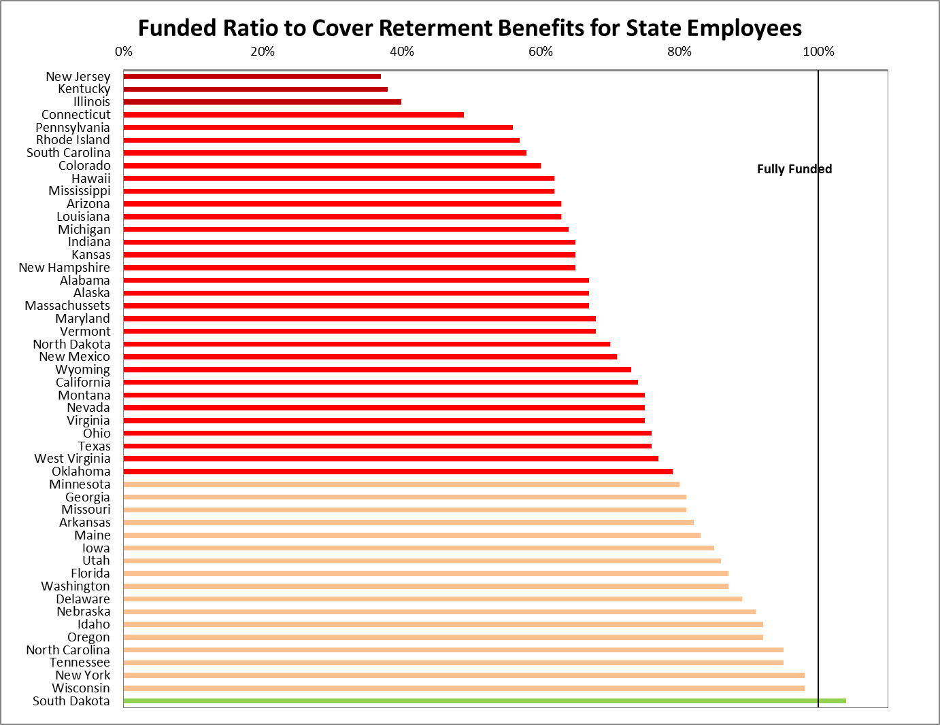
Pension Underfunding
Source: Pew Charitable Trust, Data as of Dec 2019

Slide 34
Pensions: Challenges
The pension system world wide is facing severe challenges
Underfunding of pensions, particularly public pension plans, and/or of pension guarantors (PBGC, etc). Poor performance of equities over the past 20 years and hedge funds recently has contributed to underfunding as well as nature of political system.
Dramatic increases in longevity
Intergenerational (in-)equity
Defined contribution schemes place all risk on the employee, who is less able to handle it.
Defined contribution schemes are, on average, less generous than defined benefit plans.
Ratio of workers to retirees (dependency ratio) is shrinking in developed countries.
34

Slide 35
Pensions: How Bad Is It Really
Why should you be skeptical of everything I just told you?
Why did the amount of underfunding swing by some estimates as much $2.5 trillion dollars from 2020 to 2021?
Why will the underfunding decrease in 2022 by at least the same amount?
Do you believe it is appropriate to use the risk-free rate (10 year and 20 year Treasury Bond) to discount state pension fund liabilities because “states cannot default on their pension promises”?
35

Slide 36
Foundations and Endowments

Slide 37
Payout Rules
Foundations are required to pay out at least 5% of AUM every year—established under the Tax Reform Act of 1969
University endowments are not constrained, but many pay out approximately 4-5% and only slowly change their payouts over time
Public endowments are much more transparent than private foundations
Private foundations are often used to control wealth, exempt from tax, and so the government places restrictions to force them to pay out, rather than accumulate, wealth

Slide 38
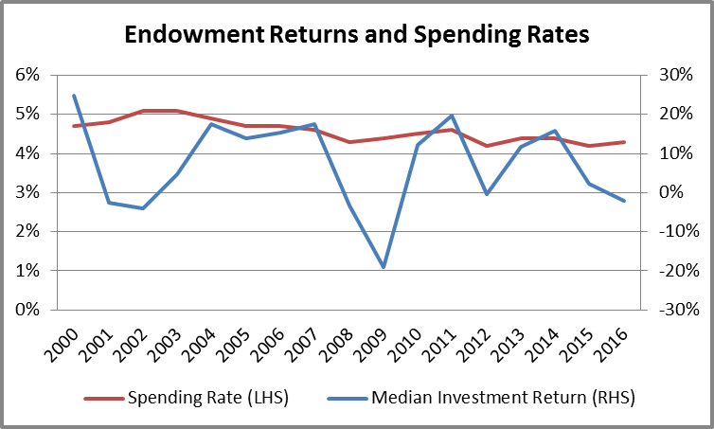
Payout Rules

Slide 39
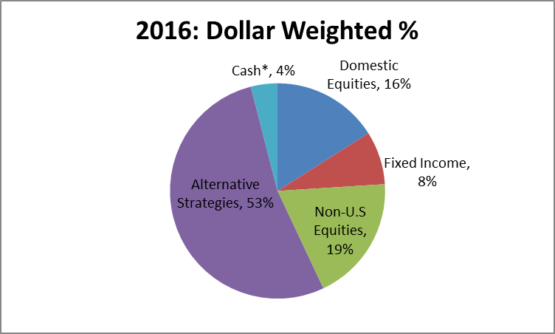
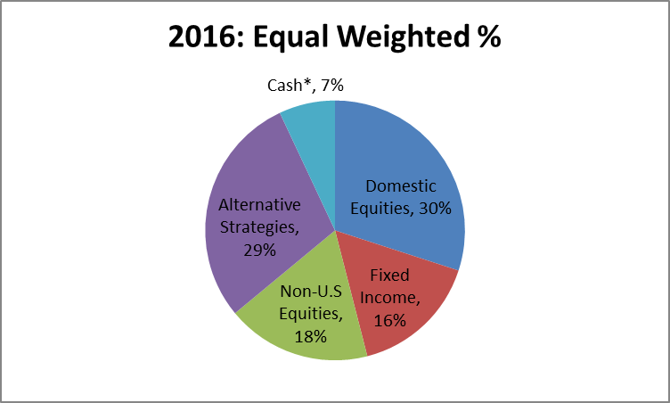
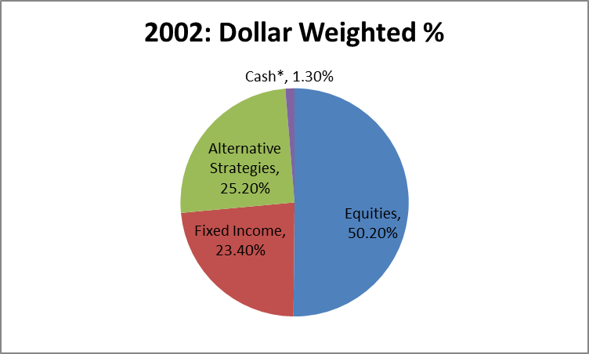
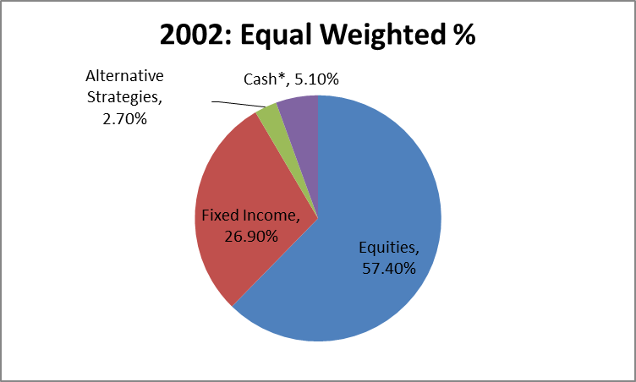
Payout Rules

Slide 40
Individuals

Slide 41
Wealth Management and Investment Opportunities for Individuals
If you are running a Wealth Management business or entering your Private Wealth Management what does your target audience look like?
How concentrated is the population you are targeting? How competitive is it?
What does your customer base look like?
Why has “robo-investing” taken off?
If you are thinking of starting a Hedge Fund who are you potential investors?
Can anyone invest in Hedge Fund? What is an accredited investor?
What is the pool of individuals you are targeting?
Same questions for a VC or a PE firm.
Or if you are building a Fin Tech product what is the potential underserved market?

Slide 42
Middle Class, Rich, and Really Rich: US Residents
2019 median annual household income: $59,050 2019 mean annual income: $112,600
Ratio ~1.9x
2004 median annual household income: $58,480 2019 median annual household income: $59,050
In real over the past 15 years, median household income has grown by <1%, in total
2019 median annual household net worth: $121,760 2019 mean annual household net worth: $746,820
1989 median annual household net worth: $93,600
1989 mean annual household net worth: $376,640
In real terms the mean household has doubled over the past 30 years while the
median household net worth has grown by 30%
In 1989, mean vs median was 4.0x
In 2019, mean vs median was 6.1x
Source: https://www.federalreserve.gov/econresdata/scf/files/BulletinCharts.pdf : (Note all numbers in 2019 dollars)

Slide 43
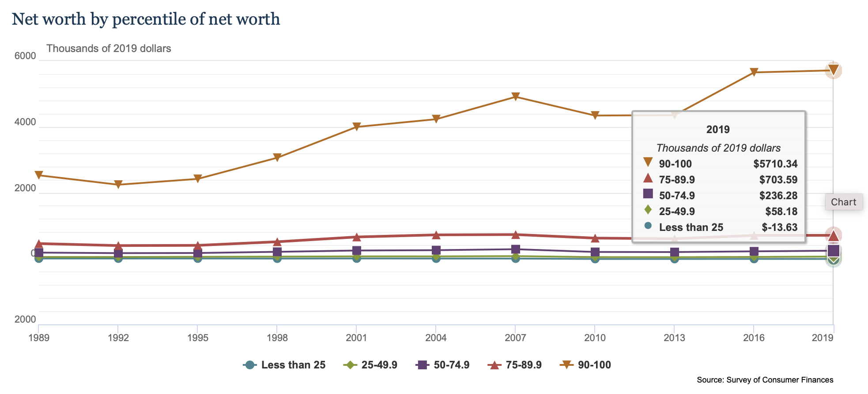
Middle Class, Rich, and Really Rich
Source: https://www.federalreserve.gov/econresdata/scf/files/BulletinCharts.pdf (Note all numbers in 2019 dollars)

Slide 44
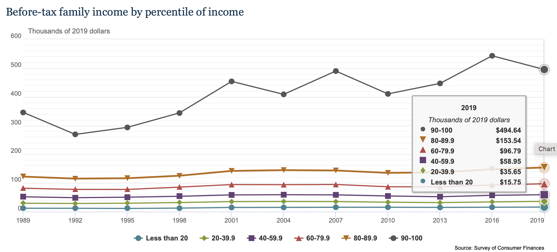
Middle Class, Rich, and Really Rich
Source: https://www.federalreserve.gov/econresdata/scf/files/BulletinCharts.pdf (Note all numbers in 2019 dollars)

Slide 45
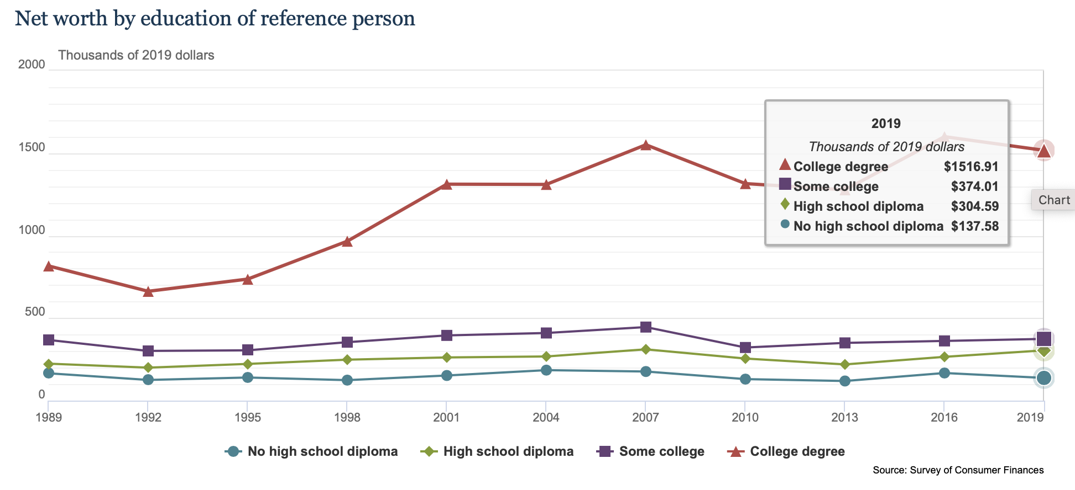
Middle Class, Rich, and Really Rich
Source: https://www.federalreserve.gov/econresdata/scf/files/BulletinCharts.pdf (Note all numbers in 2019 dollars)

Slide 46
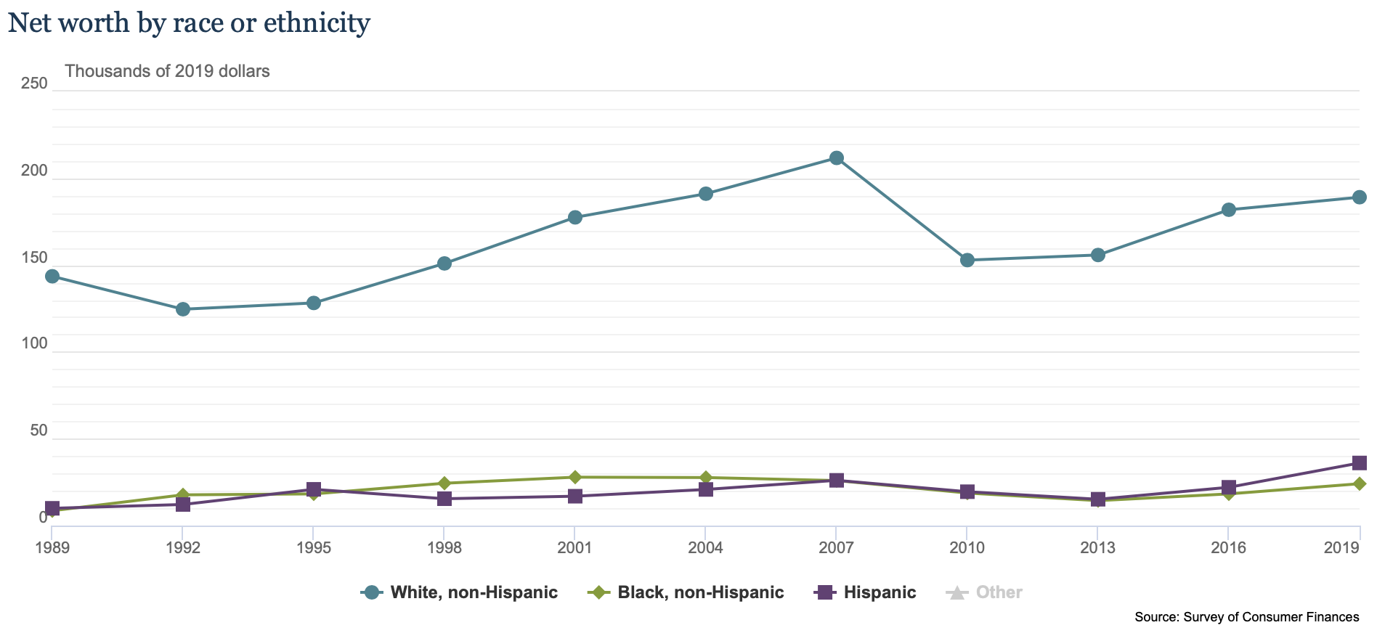
Net Worth By Race or Ethnicity (Median): US Residents
Source: https://www.federalreserve.gov/econresdata/scf/files/BulletinCharts.pdf (Note all numbers in 2019 dollars)

Slide 47
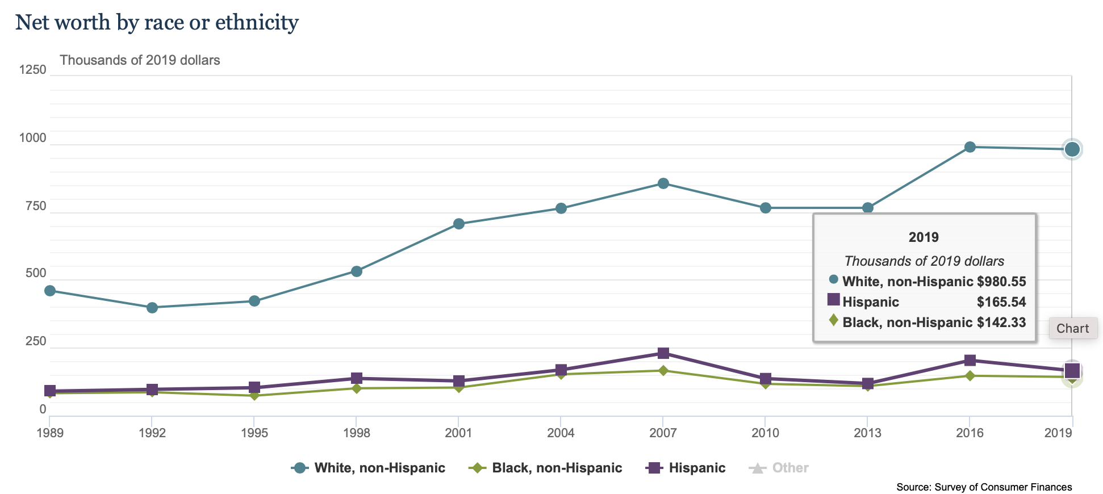
Net Worth By Race or Ethnicity (Mean): US Residents
Source: https://www.federalreserve.gov/econresdata/scf/files/BulletinCharts.pdf (Note all numbers in 2019 dollars)

Slide 48
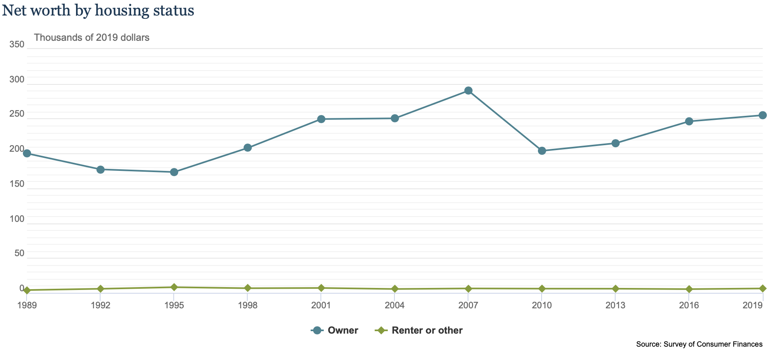
Net Worth By Housing Status (Median): US Residents
Source: https://www.federalreserve.gov/econresdata/scf/files/BulletinCharts.pdf (Note all numbers in 2019 dollars)

Slide 49
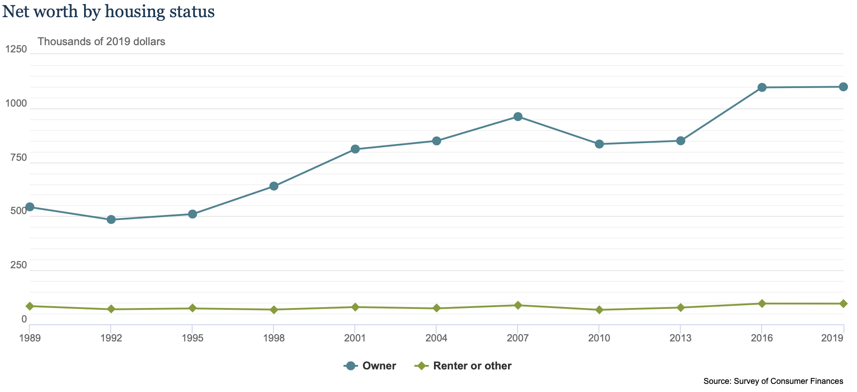
Net Worth By Housing Status (Mean): US Residents
Source: https://www.federalreserve.gov/econresdata/scf/files/BulletinCharts.pdf (Note all numbers in 2019 dollars)

Slide 50
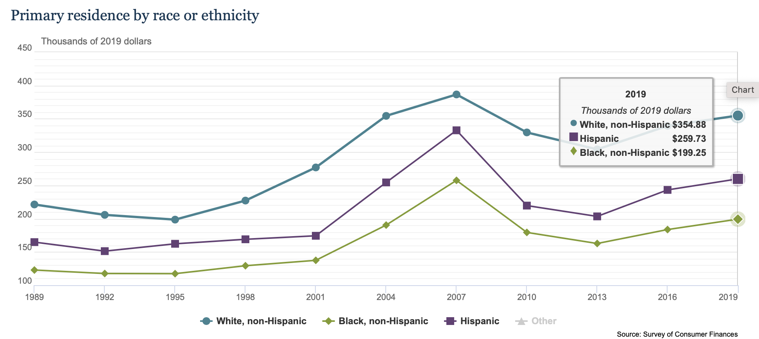
Net Worth By Housing Status and Race and Ethnicity (Mean): US Residents
Source: https://www.federalreserve.gov/econresdata/scf/files/BulletinCharts.pdf (Note all numbers in 2019 dollars)

Slide 51
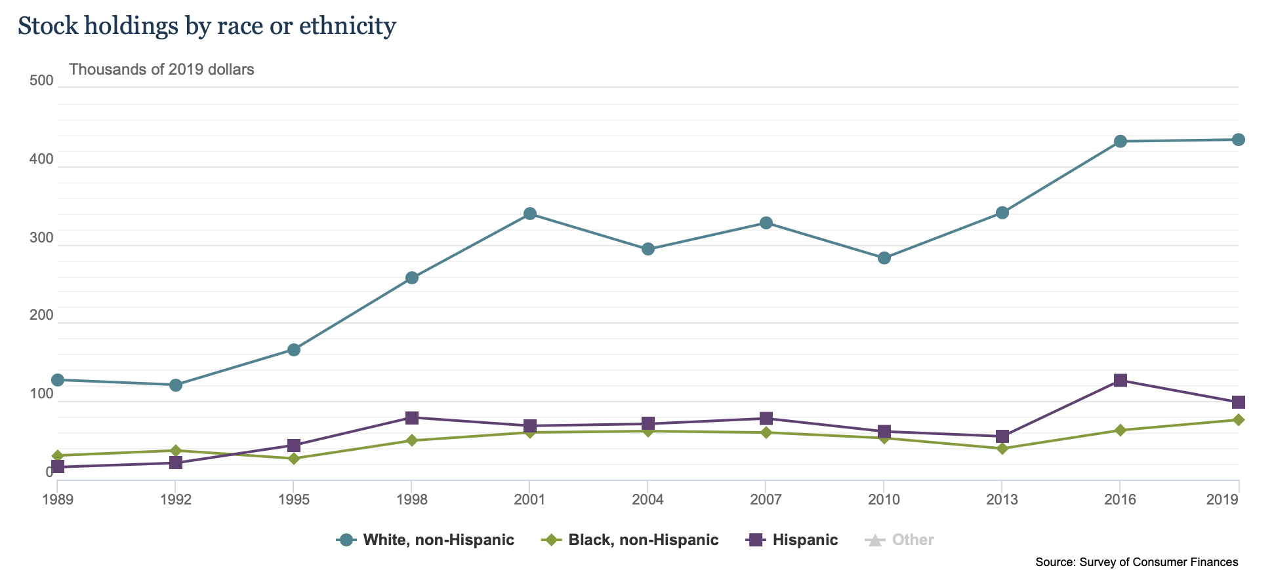
Stock Holding by Race or Ethnicity (Mean): US Residents
Source: https://www.federalreserve.gov/econresdata/scf/files/BulletinCharts.pdf (Note all numbers in 2019 dollars)

Slide 52
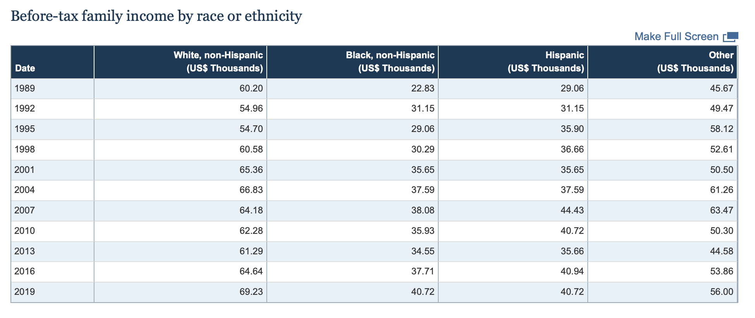
Pre-Tax Income by Race or Ethnicity (Median): US Residents
The income gap between Whites and other races and ethnicities appears to have shrunk, though, still remains substantial ….
Source: https://www.federalreserve.gov/econresdata/scf/files/BulletinCharts.pdf (Note all numbers in 2019 dollars)

Slide 53
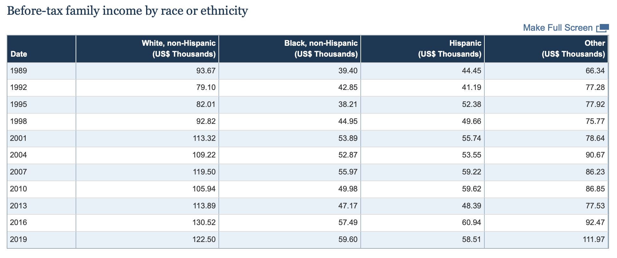
Pre-Tax Income by Race or Ethnicity (Mean): US Residents
… On further examination, not so much …. Indeed much of the income inequality is being driven by a section of Whites and “Other” out-earning everyone else (including intra-race) by a substantial amount …
Source: https://www.federalreserve.gov/econresdata/scf/files/BulletinCharts.pdf (Note all numbers in 2019 dollars)

Slide 54
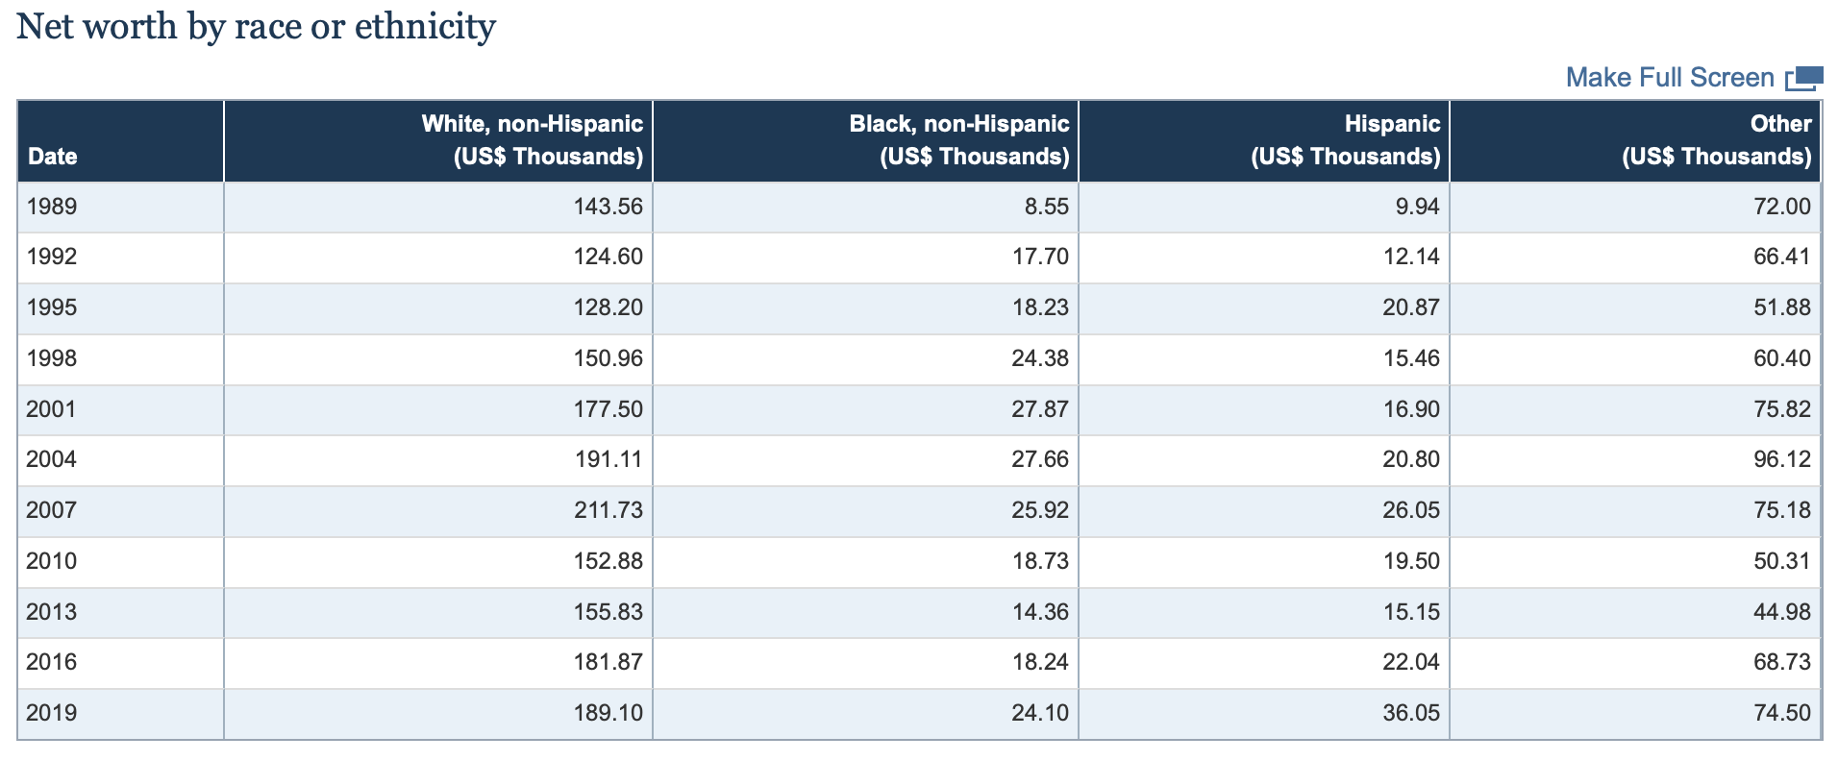
Net Worth by Race or Ethnicity (Median): US Residents
In terms of net worth, growth has been much more pronounced in Blacks and Hispanics but the overall differences with Whites is staggering ….
Source: https://www.federalreserve.gov/econresdata/scf/files/BulletinCharts.pdf (Note all numbers in 2019 dollars)

Slide 55
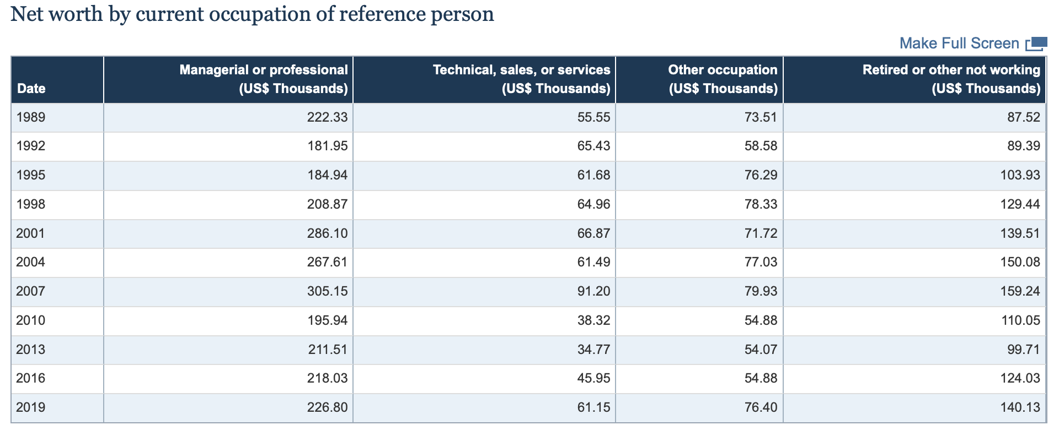
Net Worth by Occupation (Median): US Residents
Source: https://www.federalreserve.gov/econresdata/scf/files/BulletinCharts.pdf (Note all numbers in 2019 dollars)

Slide 56
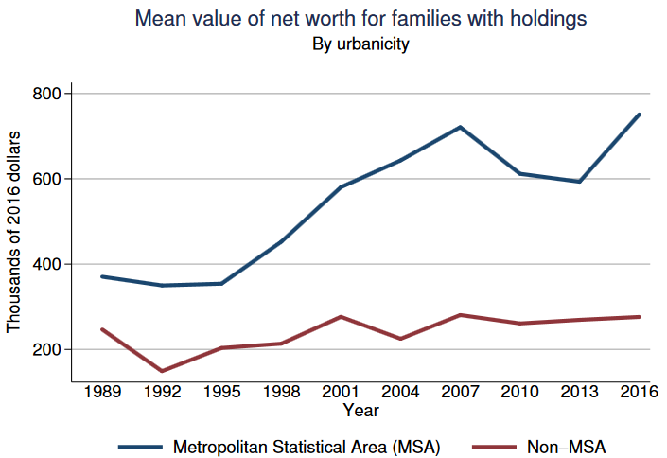
Middle Class, Rich, and Really Rich
Source: https://www.federalreserve.gov/econresdata/scf/files/BulletinCharts.pdf (Note all numbers in 2019 dollars)

Slide 57
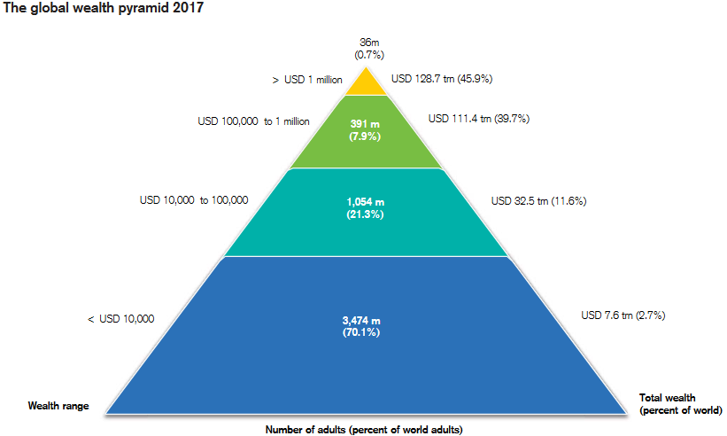
Middle Class, Rich, and Really Rich
Both half of the world adult population own < 1% of world’s total wealth
Top 1% of wealthiest people own over half of the world’s wealth.
Source: Credit Suisse Global Wealth Report 2017

Slide 58
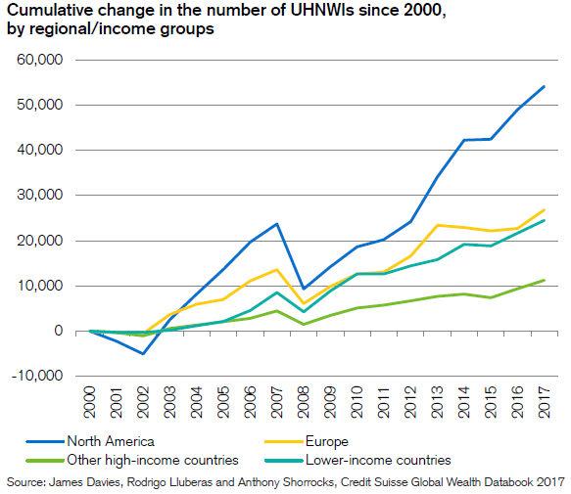
Middle Class, Rich, and Really Rich
Moderate High-net worth: $5 to $15 million in liquid assets
High high-net worth: $15 to $50 million in liquid assets
Ultra high-net worth: $50 million and above in liquid assets
The really, really rich form family offices, operating much like endowments

Slide 59
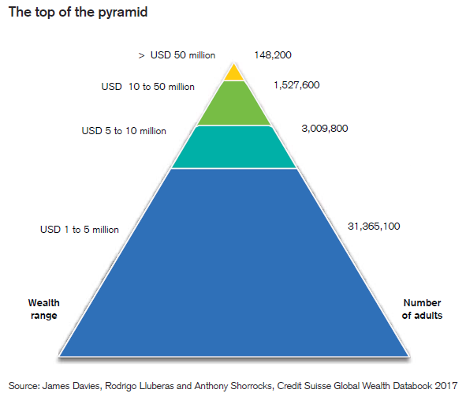
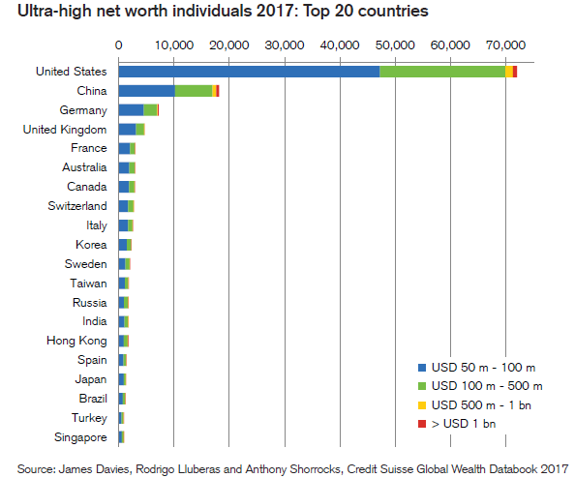
Middle Class, Rich, and Really Rich
Source: Credit Suisse Global Wealth Report 2017

Slide 60
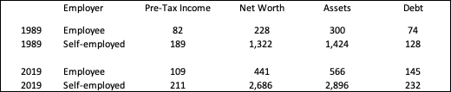
How do you get Rich?
As the old saying goes: Nobody ever gets rich on wages!
The self-employed pre-tax earn approximately twice as much employees.
They have approximately 6 times the net worth.
Questions:
How much is inherited wealth?
How much is tax avoidance or a favorable tax benefits?
How much is difference in labor?
How much is appropriate return for risk?
Source: https://www.federalreserve.gov/econresdata/scf/files/BulletinCharts.pdf
Source: Credit Suisse Global Wealth Report 2017

Slide 61
Wealth Management and Investment Opportunities for Individuals
If you are running a Wealth Management business or entering your Private Wealth Management what does your target audience look like?
How concentrated is the population you are targeting? How competitive is it?
What does your customer base look like?
Why has “robo-investing” taken off?
If you are thinking of starting a Hedge Fund who are you potential investors?
Can anyone invest in Hedge Fund? What is an accredited investor?
What is the pool of individuals you are targeting?
Same questions for a VC or a PE firm.
Or if you are building a Fin Tech product what is the potential underserved market?

Slide 62
Mathematical Aside and Thought Questions
What is the distribution (pdf) of income?
What is the distribution of net wealth?
What might the distribution have to look like to give you median values that are this much smaller than mean?
What is the distribution (pdf) of prices?
What is a reasonable distribution first-order approximation distribution for stock returns?
What is the distribution of a convolution of Normal independent distributions? Assuming correlation?
X ~ N(μ_{x}, σ²_{x}) and Y ~ N(μ_{y}, σ²_{y}) Ζ = X+Y
Z ~ N(μ_{x} + μ_{y}, σ²_{x} + σ²_{y})
Z ~ N(μ_{x} + μ_{y}, σ²_{x} + σ²_{y} + 2ρσ_{x} σ_{y})
So how might you simulate a sample of stock returns with skew? How might you simulate them with ”fat” tails?
Why might you want to do this?

Slide 63
Types of Asset Managers

Slide 64
40-Act Funds

Slide 65
40-Act
There are four types of RICs covered by the 40-Act:
Mutual funds: Securities are redeemable at net asset value (NAV)
Closed-end funds: Fixed number of shares that trade on stock exchanges, making them similar to buying or selling a stock.
Exchange-traded funds (ETFs): Hybrid vehicle legally classified as mutual funds or UITs, but trade on exchanges like closed-end funds
Unit investment trusts (UITs): Hybrid vehicle which issues a fixed number of shares (“units”) like closed-end funds. A UIT buys and holds a set of investments until a set termination date, when the UIT is dissolved and proceeds paid to shareholders
As at the end of 2020, registered investment companies managed 35% of households’ financial assets. These companies held 28% of US corporate equities.

Slide 66
40-Act: Core Principles
Transparency
The prospectus provides investors with investment objectives, strategies, risks, fees, expenses, and how to purchase, redeem, and exchange shares.
Reports are audited
Holdings are required to be listed and reported (Form N-Q)
Liquidity
Registered funds offer at least daily liquidity with market-based valuations. ETFs and closed-end funds offer intra-day, real-time liquidity. Mutual fund shares are redeemable daily at NAV.
Oversight
Boards of directors of RIC, with at least 40% independent
Required compliance programs
Monitoring by the SEC, FINRA, etc
All funds maintain strict custody of assets separate from advisers
Fiduciary duty to investors
66

Slide 67
40-Act: Core Principles
Tax Pass-Through
Investors, not funds, are taxed.
Limits on Leverage
Section 13(a) of the original Act states: “No registered investment company shall, unless authorized by the vote of a majority of its outstanding Voting Securities, borrow money”
Subsequent policy now permits mutual funds and ETFs to have 300% asset coverage
Limits on How Managers Can Be Compensated
Performance-based fees should be “symmetrical” around a chosen benchmark
Rules out “bonus” or “option” fees; restriction to linear contracts.

Slide 68
Hedge Funds

Slide 69
The First Hedge Fund: Alfred Winslow Jones
Sociologist (PhD from Columbia University), and then a journalist and diplomat
Formed a “hedged fund” in 1949
Secretive
Featured an incentive fee of 20% but no regular management fee
At the time, the income tax rate was over 90% whereas the capital gains rate was 25%. Charging only incentive fees allowed Jones to lower his tax rate by 65%!
Would that modern HFs only charge incentive fees!
Private—not a public investment company under the 40-Act

Slide 70
Famous Hedge Funds
Soros Fund Management: in the week leading up to Sep 16, 1992 (“Black Wednesday”), bet $10 billion by shorting pounds and buying Marks, leading to the title “The Man Who Broke the Bank of England”. Earned $1.8 billion in this single trade. [Global macro]
Long-Term Capital Management, LTCM: blew up September 1998. [Quant]
Amaranth: blew up September 2006 after losing $6 billion on natural gas futures. Biggest HF loss to date. [Directional but originally Convertible Arbitrage]
Renaissance Technologies Medallion Fund: Jim Simons, fees of 5/44, Sharpe ratio above 20. [Quant]
Millennium Management: Founded in 1989, first and most successful “Platform Fund”

Slide 71
Exempt from 40-Act: Definition
Hedge funds are private investment vehicles open to a limited number of wealthy or professional investors. They are characterized by
Limited number of investors and investors must be accredited or qualified purchasers (legal terms for “rich, sophisticated investors”). Minimum capital requirements are high and liquidity requirement
Usually have limited liquidity (i.e. limited access to invested capital)
Often employ leverage and use derivatives. They invest in a wide range of strategies often not available in other investment vehicles.
Are very often long-short vehicles but not always.
Are often not “hedged” in any meaningful sense.
Manager fees are very high and often have a performance component
Are [relatively] unregulated
Are not transparent

Slide 72
Data Biases
The actual size of the HF industry is unknown because it is unregulated
HFs voluntarily report their returns to several databases
CISDM: Center for International Securities and Derivatives Markets (University of Massachusetts in Amherst)
HFR: Hedge Fund Research
CSFB TASS
MSCI BARRA
Eureka Hedge
Standard and Poors
Morningstar
Overlap is small!

Slide 73
Data Biases
Why report to a database?
Attract capital, build reputation
But, HFs will wait for a good track record before starting to report => backfill bias
HFs with poor performance stop reporting => survivorship bias
The best HFs do not report to databases, e.g. Renaissance Medallion, Caxton, DE Shaw, P72, Citadel, etc
Thus, HF databases do not contain the worst left-hand tail or the best right-hand tail and are biased toward mediocrity. But the truncation from the left-hand tail outweighs the right: reported HF returns are too good.
Biases also affect how HFs are benchmarked against each other, especially for funds-of-funds (FoFs)

Slide 74
Broker-Dealers

Slide 75
Broker-Dealer
A Broker-Dealer is a firm that buys and sells securities and other financial instruments either for external clients (broker) or for their own profit (dealer).
Broker-dealers also offer financial advisory services, publish investment data and research, raise capital for clients and take part in market-making activities (providing liquidity).
Main lines of business:
Corporate Finance: Deals with the sources of funding and capital structure of corporations. It is principally advisory work.
Investment Banking: Works with institutional clients to engage in array of transactions and advisory work related to corporate structure and capital raising (M&A, spinoffs and restructuring, divestures, debt and equity offerings, private placements, corporate defense activities).
Investment Management: Provides wealth advisory services, including portfolio management, financial counseling, and other transaction services to high-net worth individuals and institutions. Two divisions: Private Wealth Management and Asset Management.

Slide 76
Broker-Dealer
Main lines of business (continued):
Sales and Trading: Responsible for facilitating client transactions across all major asset classes. They make markets in fixed income, currencies, commodities, as well as major stocks, options, and futures. Some of these instruments may be exchange traded and other OTC instruments.
Prime Brokerage Services: Provides securities lending, cash management and array of other services (e.g capital introductions, clearing and back-office functions, advisory services) to large institutional clients, predominantly hedge funds.
Investment and Market Research: Provides client focused research in equities, fixed income, currencies and commodities. They usually target mutual funds, hedge funds, pension funds and other large institutional clients. Usually broken into 5 groups: Equities; Credit; Economic Research; Portfolio Strategy Research; and Currency and Commodities.
Large Array of Back Office Functions: Supported by a large array of support functions: Technology; Legal & Compliance; Risk Management; Trade Operations & Support; and Reporting and Analytics.

Slide 77
Broker-Dealer
Questions:
Is the business model of an Global Markets business supportable any longer in the post Volker world?
With trading becoming more and more of a commodity and requiring increasingly expensive technology, what parts of Sales and Trading should Broker-Dealers be investing in?
Do you believe in the multi-business model of a modern Broker-Dealer?
Are each of these business models self-supporting? Should they be?
How should each one be “priced”? Should “bundling” be encouraged or discouraged?
What are the inherent conflicts of interest between these lines of business? And how should they be managed? Who is (dis-) advantaged by the conflicts? Think Archegos. Post tech boom Research settlement.
As Broker-Dealers do not have fiduciary duty to its customers, how you should interact with them? Why would you interact with them?

Slide 78
Summary

Slide 79
Thought Questions
What are the implications of “delegated management”? If you are giving your assets to a professional money manager – either a hedge fund or a mutual fund – how might their incentives conflict with yours? Give some real examples of where problems might arise? How could you structure a contract to deal with these issues?
What are the implications for institutional money managers that there has been a dramatic shift from defined benefit to defined contribution plans? What is the implications for how they structure their own businesses?
How does the growing wealth inequality impact the functioning of capital markets? How does it impact how institutional money managers should structure their business? What challenges would you face starting your own private wealth management business? Think about this from a broad perspective and a general industry competitive model.
Should hedge funds be exempt from regulation?

Slide 80
Thought Questions
Why should we have broker-dealers? Should all those parts exist in one firm? Is there any “social good” they are delivering? Is there a benefit to their role as intermediaries? Should Broker-Dealer have a fiduciary duty to their clients?
Why should you be suspicious of the performance data that you see about hedge fund performance?
If you were the King (or leader) of Saudi Arabia, why might you be very interested in setting up a SWF? How might you structure it? What might be your source of assets? How might you invest those assets? What might the payout plan look like? Should you be investing in Green technology?
If you were the manager of a state pension plan, how might your asset allocation differ depending upon your plans funding status? How might the risk components, as well as your return projections, of your asset allocation interact with funding status?
Do you agree with the definition of an accredited investor? If not, what would your definition be?

Slide 81
Thought Questions
Do you expect mutual funds to out-perform hedge funds over time? Does your answer differ if you were measuring performance before fess vs after fees?
What is your definition of a quantitative investment process?
What do you find to be the most compelling critiques of quantitative investing? What do you believe are its greatest strengths?
Which of the quantitative investing styles do you believe are the most difficult ones in which to achieve success? Which styles are relatively easier? Do you think that holds over the long-run? Note define “success” for you.
Do you believe today is a good time to be a quantitative investor (relative to other times in history)? What factors make it easy and/or hard today? How do you think the current macroeconomic and geopolitical environments make it harder or easier to be a quantitative investor today?
What type of quantitative investing styles do you believe most immune to macroeconomic and geopolitical shocks?

